Slide 1
Public Preview

Slide 2
Introducing Amazon SageMaker Studio Lab
Public Preview
AIM234
Michele Monclova
Emily Webber
Principal SageMaker PMT
AWS
Sr. ML Specialist SA
AWS

Slide 3
Our vision Make machine learning and data science accessible to all customers (learners, developers, data scientists)

Slide 4
Lack of data science and machine learning talent slows down innovation
250K
122K
13%
Quanthub-estimated data science skills gap in 2020
Open data science jobs on LinkedIn in November 2021
VentureBeat percentage of DSML projects that make it into production

Slide 5



How do most people learn about data science?
G
towards
data science
MOOCs and universities
Blog posts
GitHub
On-the-job training and hackathons
Jupyter IDEs

Slide 6
What do our customers want?
Academics
I want the right skills for a great career
Basic theory and learn Python/R
Developers
I want to expand my technical skills with data science
+
{…}
Learn Python/R
corporate data
Environment to practice
Data scientists
I want experiment ML and move them into production
Data science communities

Slide 7
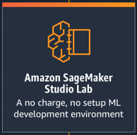
What aspiring data scientists need
→
Jupyter notebook environment
Easy to get started
Satisfactory compute
Time to code
Version control management
Supportive community
Full support of shell commands
Based on JupyterLab
Free, no cloud infrastructure setup
CPU (T3.Xl) and GPU (G4D.XL)
Save ML project, pick up where left
Integrated with Git
Integrated with GitHub
Terminal access
→
→
→
→
→
→

Slide 8
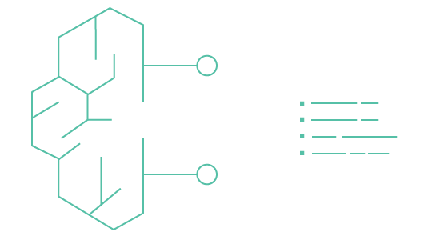
What is Amazon SageMaker Studio Lab
A Jupyter notebook service to help customers master their skills
Create an account with an email address – free
Amazon SageMaker Studio Lab
No setup or configuration required
A no-charge, no-configuration service that enable data scientists to learn and experiment with machine learning
15 GBs to save your work projects.
As many compute sessions as you need –
CPU (12 hrs)/GPU (4 hrs)
Access any notebook on GitHub
Migrate to SageMaker Studio when ready

Slide 9
Provides a beginners view to the stack
Amazon SageMaker
PREPARE
SageMaker Ground Truth Label training data for machine learning
SageMaker Data Wrangler Aggregate and prepare data for machine learning
SageMaker Processing Built-in Python, BYO R/Spark
SageMaker Feature Store Store, update, retrieve, and share features
SageMaker Clarify Detect bias and understand model predictions
BUILD
SageMaker Studio Notebooks Jupyter notebooks with elastic compute and sharing
Built-in and bring- your-own algorithms Dozens of optimized algorithms or bring your own
Local mode Test and prototype on your local machine
SageMaker Autopilot Automatically create machine learning models with full visibility
SageMaker JumpStart Pre-built solutions for common use cases
TRAIN & TUNE
Managed training Distributed infrastructure management
SageMaker Experiments Capture, organize, and compare every step
Automatic model tuning Hyperparameter optimization
Distributed training libraries Training for large datasets and models
SageMaker Debugger Debug and profile training runs
Managed Spot training Reduce training cost by 90%
DEPLOY & MANAGE
Managed deployment Fully managed, ultra low latency, high throughput
Kubernetes and Kubeflow Integration Simplify Kubernetes-based machine learning
Multi-model endpoints Reduce cost by hosting multiple models per instance
SageMaker Model Monitor Maintain accuracy of deployed models
SageMaker Edge Manager Manage and monitor models on edge devices
SageMaker Pipelines Workflow orchestration and automation
NEW
SageMaker Studio Integrated development environment (IDE) for ML

Slide 10
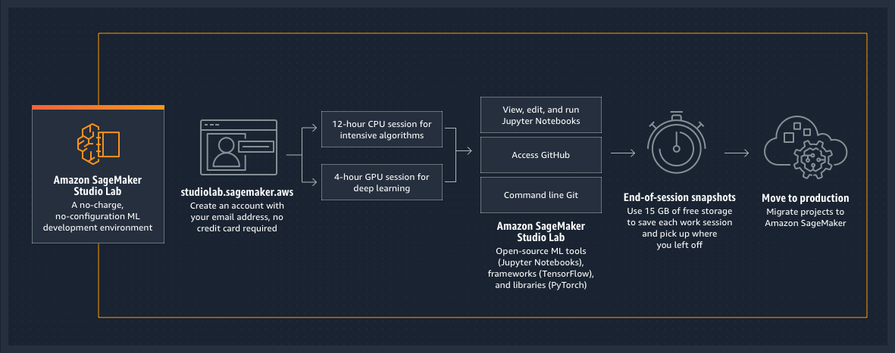
How does it work?

Slide 11
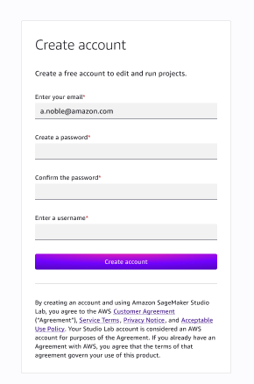

https://studiolab.sagemaker.aws/ Request and register for an account; no credit card or AWS account required

Slide 12
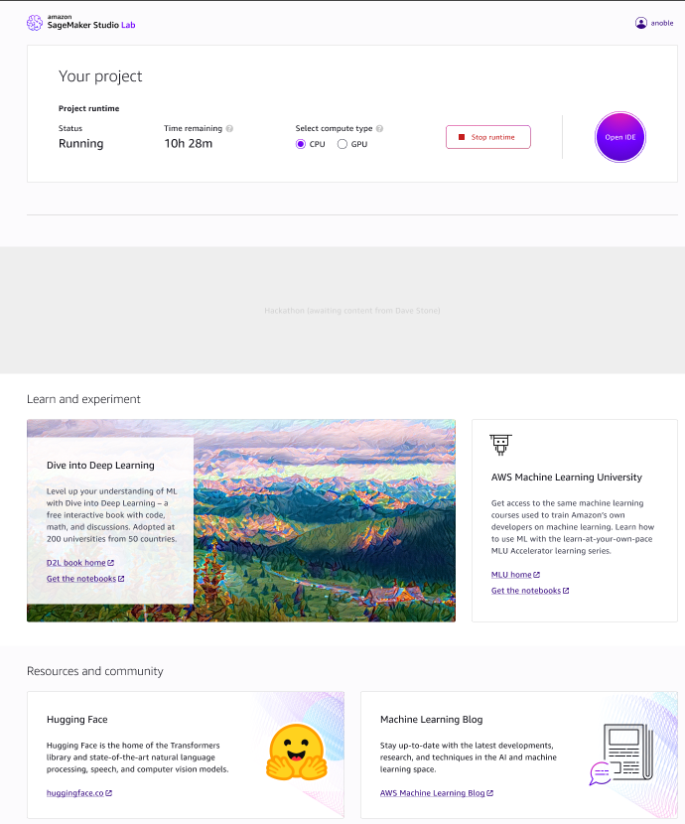
Project page
Status of your project
Time remaining
Select runtime type
Start or stop instance
Start a user session
CPU—12 hours
GPU—4 hours
Open project (in a new browser tab)
Assets to get you started
Dive into Deep Learning
AWS Machine Learning University
Hugging Face
Popular blogs
Community links

Slide 13
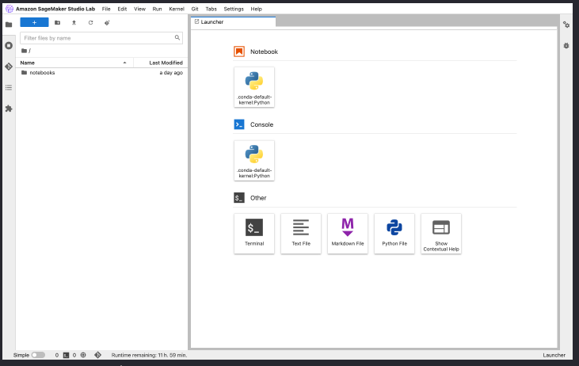
Notebook development environment
Familiar JupyterLab experience
Terminal access
Git/GitHub
Your ML environment on AWS
Compute dedicated to you
12 hours CPU/4 hours GPU
Install the libraries you want
Dedicated 15 GB for your project
Unlimited user sessions
Pick up where you left off

Slide 14

Beta customer quotes
“At Hugging Face, our mission is to democratize state-of-the-art machine learning (ML). With Amazon SageMaker Studio Lab, AWS is doing just that by enabling anyone to learn and experiment with ML through a web browser, without the need for a high-powered PC or a credit card to get started. This makes ML more accessible and easier to share with the community. We are excited to be part of this launch and contribute Hugging Face transformers examples and resources to make ML even more accessible!”

Slide 15


What universities are saying
"Amazon SageMaker Studio Lab will help my students learn the building blocks of machine learning by removing the cloud configuration steps required to get started. Now, in my natural language processing classes, students have more time to enhance their skills.”
Sanjiv Das, Professor of Finance and Data Science at Santa Clara University
"One of the hardest parts about programming with machine learning is configuring the environment to build. Students usually have to choose the compute instances, security polices, and provide a credit card. My students needed Amazon SageMaker Studio Lab to abstract away all of the complexity of setup and provide a free powerful sandbox to experiment. This lets them write code immediately without needing to spend time configuring the ML environment.”
Dan Roth, Distinguished Professor of Computer and Information Science at the University of Pennsylvania

Slide 16



AWS Heroes
Kesha Williams is an AWS Machine Learning Hero and a Principal AWS Training Architect with A Cloud Guru
Cyrus Wong, Data Scientist at Hong Kong IVE, AWS Machine Learning Hero
Mike Chambers, AI/ML Teacher at https://mikegchambers.teachable.com/

Slide 17
Demo

Slide 18
Demo – Highlights
How to get started
Clone a Repo
Customize the environment
Save project
Return
Save to GitHub

Slide 19
Recap and highlights
Accessing SageMaker Studio Lab: https://studiolab.sagemaker.aws/
You do have to request access/approvals are sent via email
Re:Invent attendees get priority access
One account = one user session at a time, as many times as you want
One user session is 12 max hours for CPU and max 4 hours for GPU
You can leave training jobs running
JupyterLab environment is open
Pip install your own libraries with % not !
At least 15 GB to save your project

Slide 20


Slide 21




Announcing the global AWS Disaster Response Hackathon
Improve disaster response with machine learning
December 1, 2021 through February 7, 2022
Total of $54,000 USD in prizes – join today!
AWSDisasterResponse.devpost.com

Slide 22
Michele Monclova
Emily Webber
monclom@amazon.com
egwebber@amazon.com
https://studiolab.sagemaker.aws/

